Slide 1
System Testing
CSE 4495- Lecture 4 - 08/11/2022
Instructor : Md. Mohaiminul Islam

Slide 2
Testing Stages
We interact with systems
through interfaces.
APIs, GUIs, CLIs
Systems built from subsystems.
With their own interfaces.
Subsystems built from units.
API
GUI
CLI
API
API
Communication via method calls.
Set of methods is an interface.

Slide 3
Testing Stages
Unit Testing
Do the methods of a class work?
System-level Testing
System (Integration) Testing
API
GUI
CLI
API
(Subsystem-level) Do the collected units work?
(System-level) Does high-level interaction through APIs/UIs work?
API
Exploratory Testing
Does interaction through GUIs work?

Slide 4
Lecture Goals
Discuss testing at the system level.
System (Integration) Testing versus Unit Testing.
Introduce process for creating System Tests.
Identify a Independently Testable Function
Identify Choices
Identify Representative Values
Generate Test Case Specifications
Generate Concrete Test Cases

Slide 5
System Testing
Tests the integration of units as a whole.
Integrate units in one subsystem.
Then integrate the subsystems.
Test through a defined interface.
Focus on showing that functionality accessed through interfaces is correct.
Subsystems: “Top-Level” Class, API
System: API, GUI, CLI, …

Slide 6
Unit vs System Testing
Unit tests focus on a single class.
Simple functionality, more freedom.
Few method calls.
System tests bring many classes together.
Focus on testing through an interface.
One interface call triggers many internal calls.
Slower test execution.
May have complex input and setup.

Slide 7
System Testing and Requirements
Tests can be written early in the project.
Requirements discuss high-level functionality.
Can create tests using the requirements.
System testing does not require a detailed design.
Creating tests supports requirement refinement.
Tests can be made concrete once code is built.

Slide 8
Interface Types
Parameter Interfaces
Data passed from through method parameters.
Subsystem may have interface class that calls into underlying classes.
Procedural Interfaces
Interface surfaces a set of functions that can be called by other components or users (API, CLI, GUI).
Integrates lower-level components and controls access.

Slide 9
Interface Types
Shared Memory Interfaces
A block of memory is shared between (sub)systems.
Data placed by one (sub)system and retrieved by another.
Common if system architected around data repository.
Message-Passing Interfaces
One (sub)system requests a service by passing a message to another.
A return message indicates the results.
Common in parallel systems, client-server systems.

Slide 10
Interface Errors
Interface Misuse
Malformed data, order, number of parameters.
Interface Misunderstanding
Incorrect assumptions made about called component.
A binary search called with an unordered array.
Timing Errors
Producer of data and consumer of data access data in the wrong order.

Slide 11
Creating System-Level Test Cases

Slide 12
Creating System-Level Tests
Identify an Independently Testable Function
Identify a function that can be tested in (relative) isolation.
Identify Choices
Identify controllable aspects of the input and environment that determine the outcome of the function.
Identify Representative Input Values
Identify types of values for each choice that lead to different function outcomes.
Generate Test Case Specifications
Combine values to form “recipes” for test cases.
Generate Test Cases
Replace representative values with concrete values.

Slide 13
Independently Testable Functionality
Identify an Independently Testable Function
A well-defined function that can be tested in (relative) isolation.
Based on the “verbs” - what can we do with this system?
The high-level functionality offered by an interface.
UI - look for user-visible functions.
Web Forum: Sorted user list can be accessed.
Accessing the list is a testable functionality.
Sorting the list is not (low-level, unit testing target)

Slide 14

Units and “Functionality”
Identify an Independently Testable Function
Many tests written in terms of “units” of code.
An independently testable function is a capability of the software.
Can be at class, subsystem, or system level.
Defined by an interface.

Slide 15
Identify Input Choices
Identify Choices
What choices do we make when using a function?
Anything we control that can change the outcome.
What are the inputs to that feature?
What configuration choices can we make?
Are there environmental factors we can vary?
Networking environment, file existence, file content, database connection, database contents, disk utilization,
…

Slide 16
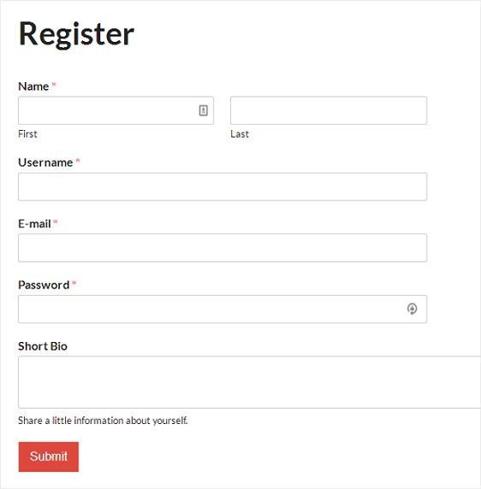
Ex: Register for Website
Identify Choices
What are the inputs to that feature?
(first name, last name, date of birth, e-mail)
Website is part of product line with different database options.
(database type)
Consider implicit environmental factors.
(database connection, user already in database)

Slide 17
Parameter Characteristics
Identify Choices
Identify choices by understanding how parameters are used by the function.
Type information is helpful.
firstName is string, database contains UserRecords.
… but context is important.
Reject registration if in database.
… or database is full.
… or database connection down.

Slide 18
Parameter Context
Identify Choices
Input parameter split into multiple “choices” based on contextual use.
“Database” is an implicit input for User Registration, but it leads to more than one choice.
“Database Connection Status”, “User Record in Database”, “Percent of Database Filled” influence function outcome.
The Database “input” results in three input choices when we design test cases.

Slide 19
Examples
Identify an Independently Testable Function
Class Registration System
What are some independently testable functions?
Register for class
Drop class
Transfer credits from another university
Apply for degree

Slide 20
Example - Register for a Class
Identify Choices
What are the choices we make when we design a test case?
Course number to add
Student record
What about a course database? Student record database?
What else influences the outcome?

Slide 21
Example - Register for a Class
Identify Choices
Student Record is an implicit input choice.
How is it used?
Have you already taken the course?
Do you meet the prerequisites?
What university are you registered at?
Can you take classes at the university the course is offered at?

Slide 22
Example - Register for a Class
Identify Choices
Potential Test Choices:
Course to Add
Does course exist?
Does student record exist?
Has student taken the course?
Which university is student registered at?
Is course at a valid university for the student?
Can student record be retrieved from database?
Does the course exist?
Does student meet the prerequisites?

Slide 23
Creating System-Level Tests
Identify an Independently Testable Function
Identify a function that can be tested in (relative) isolation.
Identify Choices
Identify controllable aspects of the input and environment that determine the outcome of the function.
Identify Representative Input Values
Identify types of values for each choice that lead to different function outcomes.
Generate Test Case Specifications
Combine values to form “recipes” for test cases.
Generate Test Cases
Replace representative values with concrete values.

Slide 24
Identifying Representative Values
Identify Representative Input Values
We know the functions.
We have a set of choices.
What values should we try?
Test Input Data
For some choices, finite set.
For many, near-infinite set.
Program
What about exhaustively trying all options?
Test Output Results

Slide 25
Not all Inputs are Created Equal
Identify Representative Input Values
Many inputs lead to same outcome.
Some inputs better at revealing faults.
We can’t know which in advance.
Tests with different input better than tests with similar input.
Test Input Data
I
Program
Test Output Results
O

Slide 26


Input Partitioning
Identify Representative Input Values
Consider possible values for a variable.
Faults sparse in space of all inputs, but dense in parts where they appear.
Similar input to failing input also likely to fail.
Try input from partitions, hit dense fault space.

Slide 27
Equivalence Class
Identify Representative Input Values
Divide the input domain into equivalence classes.
Inputs from a group interchangeable (trigger same outcome, result in the same behavior, etc.).
If one input reveals a fault, others in this class (probably) will too. In one input does not reveal a fault, the other ones (probably) will not either.
Partitioning based on intuition, experience, and common sense.

Slide 28
Example
Identify Representative Input Values
substr(string str, int index)
What are some possible partitions?
index < 0
index = 0
index > 0
str with length < index
str with length = index
str with length > index
...

Slide 29
Choosing Input Partitions
Identify Representative Input Values
Equivalent output events.
Ranges of numbers or values.
Membership in a logical group.
Time-dependent equivalence classes.
Equivalent operating environments.
Data structures.
Partition boundary conditions.

Slide 30
Look for Equivalent Outcomes
Identify Representative Input Values
Look at the outcomes and group input by the outcomes they trigger.
Example: getEmployeeStatus(employeeID)
Outcomes include: Manager, Developer, Marketer, Lawyer, Employee Does Not Exist, Malformed ID
Abstract values for choice employeeID.
Can potentially break down further.

Slide 31
Look for Ranges of Values
Identify Representative Input Values
Divide based on data type and how variable used.
Ex: Integer input. Intended to be 5-digit:
< 10000, 10000-99999, >= 100000
Other options: < 0, 0, max int
Can you pass it something non-numeric? Null pointer?
Try “expected” values and potential error cases.

Slide 32
Look for Membership in a Group
Identify Representative Input Values
Consider the following inputs to a program:
A floor layout
A country name.
All can be partitioned into groups.
Apartment vs Business, Europe vs Asia, etc.
Many groups can be subdivided further.
Look for context that an input is used in.

Slide 33
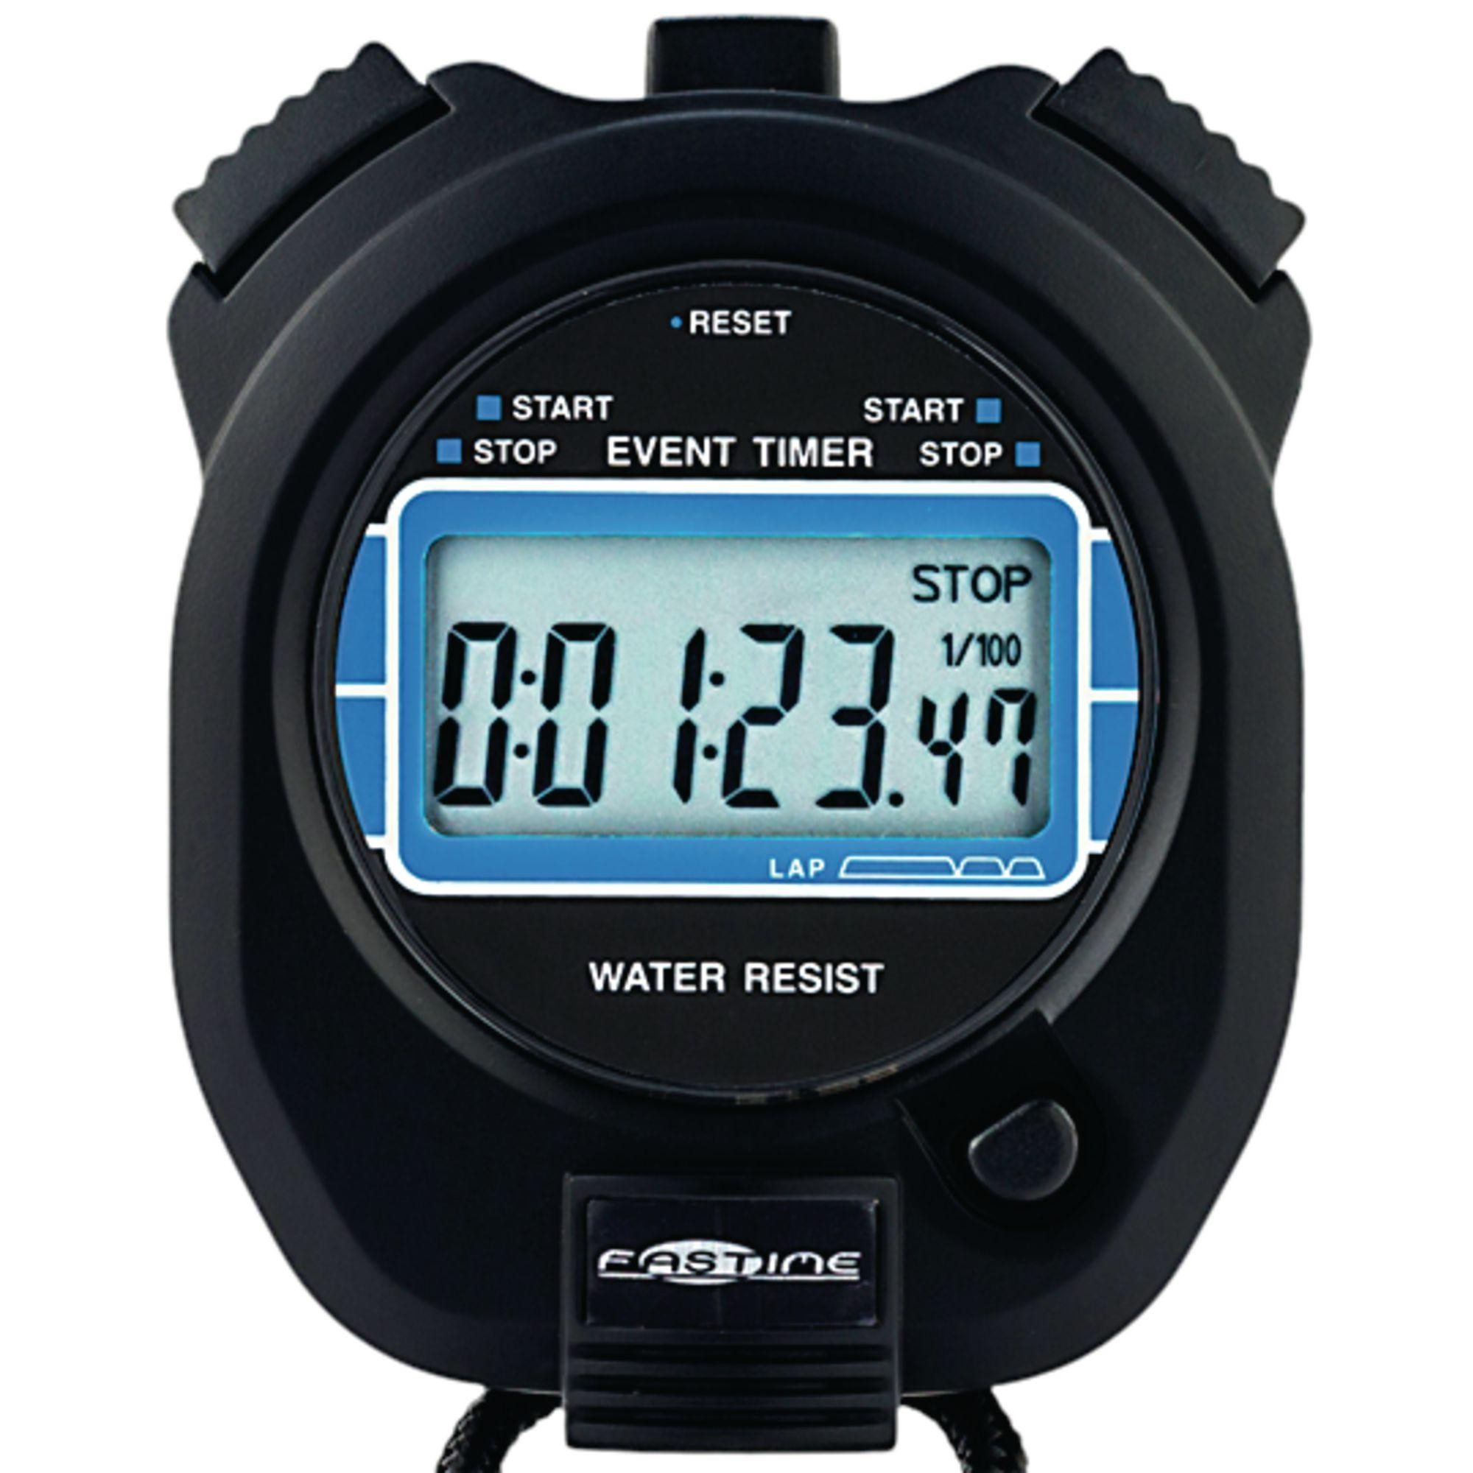
Timing Partitions
Identify Representative Input Values
Timing and duration of an input may be as important as the value.
Timing often implicit input.
Trigger an electrical pulse 5ms before a deadline, 1ms before the deadline, exactly at the deadline, and 1ms after the deadline.
Close program before, during, and after the program is writing to (or reading from) a disc.

Slide 34
Operating Environments
Identify Representative Input Values
Environment may affect behavior of the program.
Environmental factors can be partitioned.
Memory may affect the program.
Processor speed and architecture.
Client-Server Environment
No clients, some clients, many clients
Network latency
Communication protocols (SSH vs HTTPS)

Slide 35
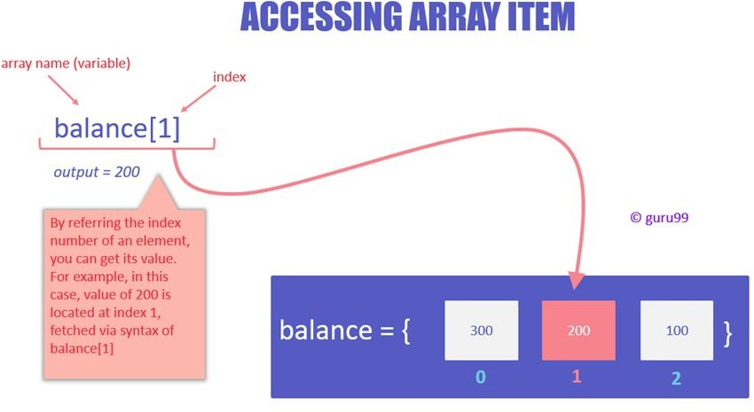
Data Structures
Identify Representative Input Values
Data structures are prone to certain types of errors.
For arrays or lists:
Only a single value.
Different sizes and number filled.
Order of elements: access first, middle, and last elements.

Slide 36
Input Partition Example
Identify Representative Input Values
What are the input partitions for:
max(int a, int b) returns (int c)
We could consider a or b in isolation:
a < 0, a = 0, a > 0
Consider combinations of a and b that change outcome:
a > b, a < b, a = b

Slide 37
Revisit the Roadmap
For each testing choice for a function, we want to:
Identify Representative Values
Generate Test Case Specifications
Partition each choice into representative values.
Choose a value for each choice to form a test specification.
Assigning concrete values from each partition.
Generate Test Cases

Slide 38
Forming Specification
Generate Test Case Specifications
Function insertPostalCode(int N, list A).
Choice: int N
5-digit integer between 10000 and 99999
Representative Values: <10000, 10000-99999, >100000
Choice: list A
list of length 1-10
Representative Values: Empty List, List of Length 1, List Length 2-10, List of Length > 10

Slide 39
Forming Specifications
Generate Test Case Specifications
Choose concrete values for each combination of input partitions:
insertPostalCode(int N, list A)
int N
Test Specifications:
(3 * 4 = 12 abstract specifications)
< 10000
10000 - 99999
> 99999
 |  | insert(< 10000, Empty List)
 |  | insert(10000 - 99999, list[1])
 |  | insert(> 99999, list[2-10]) ...
list A
Empty List
List[1]
List[2-10]
List[>10]
Concrete Test Cases:
insert(5000, {})
(Each specification = 1000s of potential test cases)
insert(96521, {11123})
insert(150000, {11123, 98765})
...

Slide 40
Generate Test Cases
Generate Test Cases
Generate Test Case Specifications
substr(string str, int index)
Specification:
str: length >=2, contains special characters index: value > 0
Generate Test Cases
Test Case:
str = “ABCC!\n\t7”
index= 5

Slide 41


Boundary Values
Generate Test Cases
Errors tend to occur at the boundary of a partition.
Remember to select inputs from those boundaries.

Slide 42


Boundary Values
Generate Test Cases
Choose test case values at the boundary (and typical) values for each partition.
If an input is intended to be a 5-digit integer between 10000 and 99999, you want partitions:
<10000, 10000-99999, >100000
0
5000
9999
100000
150000
max int
10000
50000
99999

Slide 43
Example - Set Microservice
Microservice related to Sets:
void insert(Set set, Object obj)
Boolean find(Set set, Object obj)
void delete(Set set, Object obj)
For each function, identify choices.
For each choice, identify representative values.
Create test specifications with expected outcomes.

Slide 44
Example - Set Microservice
void insert(Set set, Object obj)
Identify an Independently Testable Function
What are our choices?
Identify Choices
Parameter: set
Choice 1: Number of items in the set
Parameter: obj
Choice 2: Is obj already in the set?
Choice 3: Type of obj (e.g., valid, invalid, null)

Slide 45
Example - Set Microservice
void insert(Set set, Object obj)
Parameter: obj
Identify Representative Input Values
Parameter: set
Choice: Is obj already in the set?
Representative Values:
Choice: Number of items in the set
Representative Values:
obj already in set
obj not in set
Empty Set
Set with 1 item
Set with 10 items
Set with 10000 items
Choice: Type of obj
Representative Values:
Valid obj
Null obj

Slide 46
Example - Set Microservice
Generate Test Case Specifications
void insert(Set set, Object obj)
(4 * 2 * 2) = 16 specifications
Some are invalid (null in set). Can remove/ignore those.
Each can become 1+ test cases.
Generate Test Cases
(1 item, Yes, Valid) becomes:
insert({“Bob”}, “Bob”);
Set Size | Obj in Set | Obj Status | Outcome
Empty | No | Valid | Obj added to Set
Empty | No | Null | Error or no change
1 item | Yes | Valid | Error or no change
1 item | No | Valid | Obj added to Set
1 item | No | Null | Error or no Change
10 items | Yes | Valid | Error or no change
10 items | No | Valid | Obj added to Set
10 items | No | Null | Error or no Change
10000 | Yes | Valid | Error or no change (may be slowdown)
10000 | No | Valid | Obj added to Set(may be slowdown)
10000 | No | Null | Error or no Change (may be slowdown)

Slide 47
Creating System Tests for a REST API with Postman

Slide 48
Postman
Testing and development framework for systems with a REST API.
A system interface with endpoints we can interact with.
At an endpoint, we can send HTTPS request to:
GET information that you are interested in.
DELETE the information stored.
PUT information into what is stored (ex: create a new entry)
POST information (ex: update an existing record)
Create requests and test cases using Postman.

Slide 49
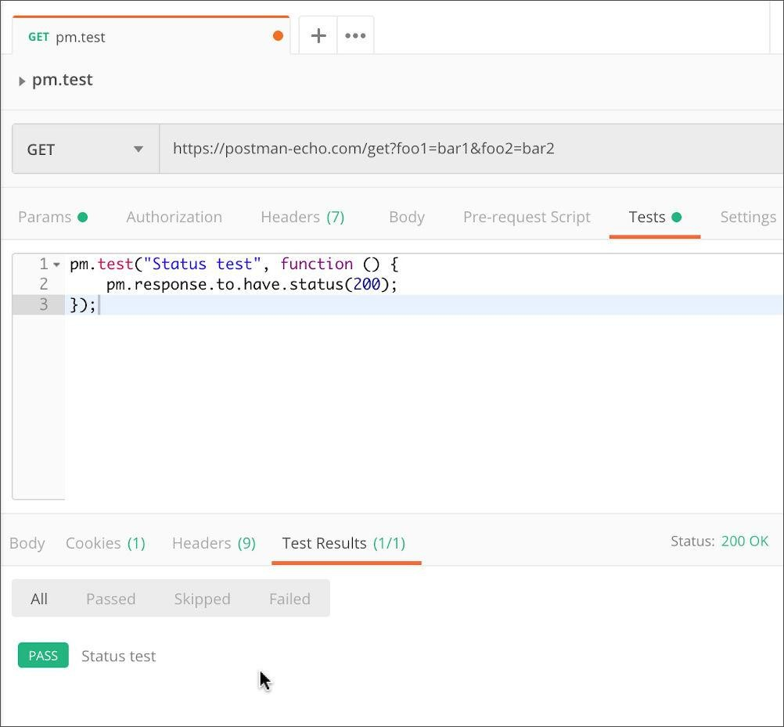
Writing Tests in Postman
Test Input
Each tab is a request.
The request is the test input.
(GET/POST/PUT/DELETE) to an endpoint.
Can specify body, header, authorization, etc. for the request.
Test Oracle
Tests tab allows creation of
test oracles.
Write small JavaScript methods to check correctness of output.

Slide 50
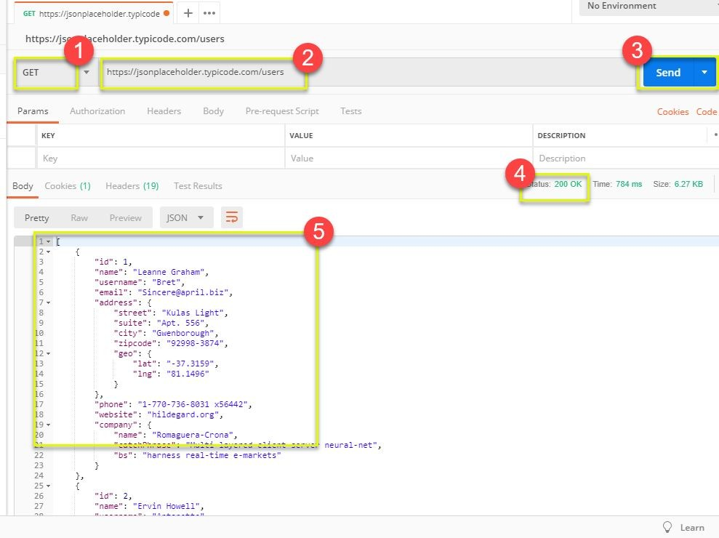
Input - GET
Select GET as the request type.
Set the endpoint URL.
Click “Send”
The response status is indicated.
The body contains the returned information.
Adapted from https://www.guru99.com/postman-tutorial.html

Slide 51
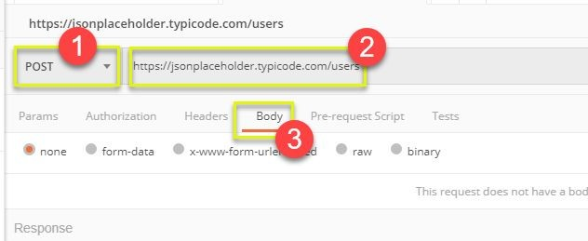
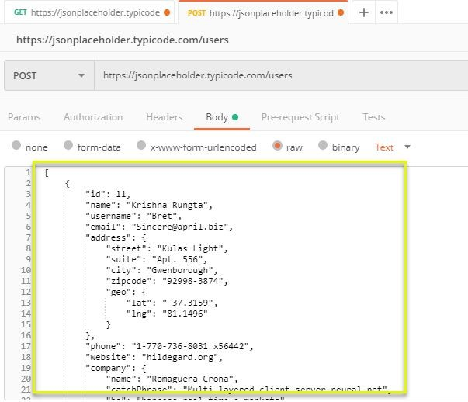
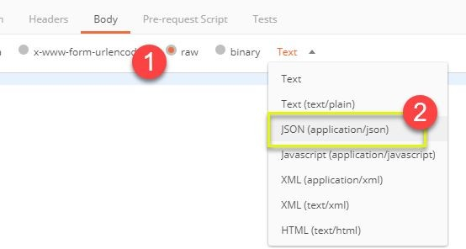


Input - POST
Set request to POST.
Set the endpoint URL.
Select the “Body” tab.
Click “raw” (raw text), “binary” (file/executable), etc.
Select data format (JSON, XML, etc.)
Add user data in proper JSON format.
Adapted from https://www.guru99.com/postman-tutorial.html

Slide 52
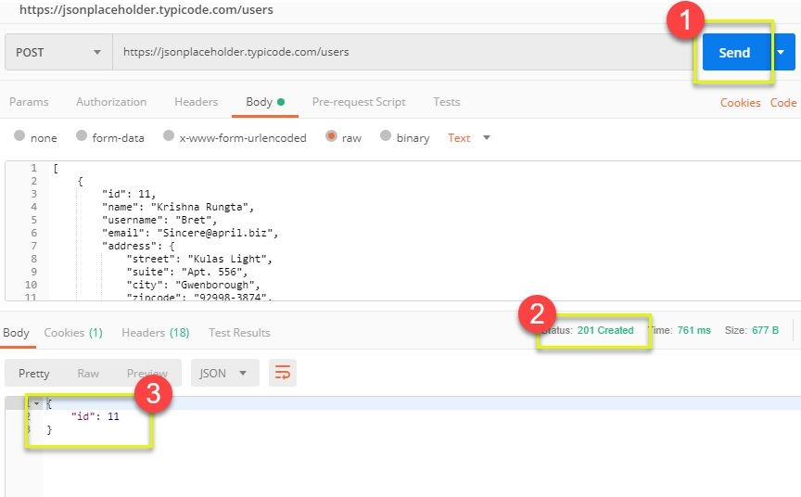
Output - POST
Click Send to send request.
Response status is indicated (201, data created)
Body indicates record “11” was created.
Adapted from https://www.guru99.com/postman-tutorial.html

Slide 53
Creating Test Oracles
Tests tab allows creation of JavaScript blocks used to verify results.
These are “test oracles”.
Embed expectations on results and code to compare expected and actual values.
pm.test library gives variety of commands to make assertions on output.
https://learning.postman.com/docs/writing-scripts/script-re ferences/test-examples/ (many example scripts!)
57

Slide 54
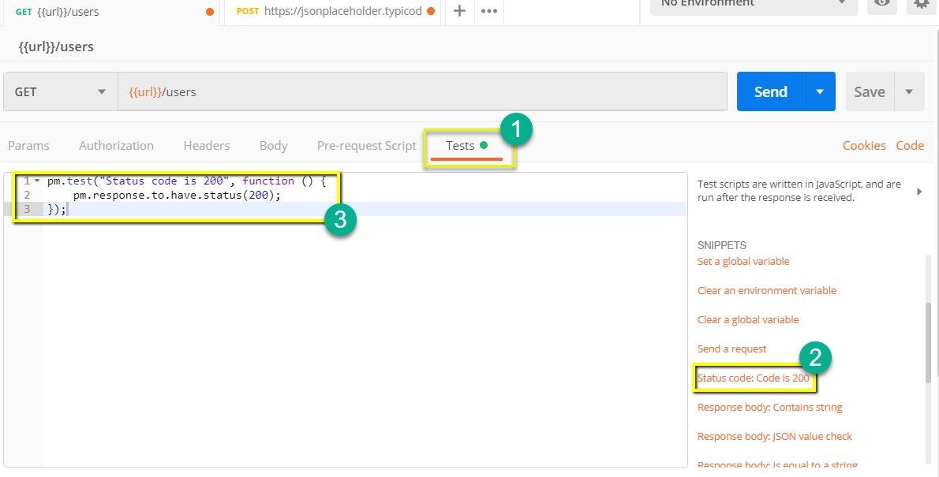
Oracle Example - Status Check
Create test in “tests tab”
Snippets offer pre-built test oracles.
Example - “status code must be 200”
Adapted from https://www.guru99.com/postman-tutorial.html

Slide 55
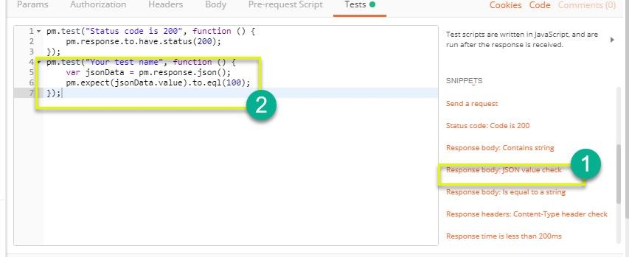
Oracle Example - Expected Value
Choose snippet
“JSON value check”
This inserts generic test body.
Change test name, variable to check (name of the first user), value to check (check for name “Leanne Graham”).
3
pm.test("Check if user with id1 is Leanne Graham", function () {
var jsonData = pm.response.json(); pm.expect(jsonData[0].name).to.eql("Leanne
Graham");
});
Adapted from https://www.guru99.com/postman-tutorial.html

Slide 56
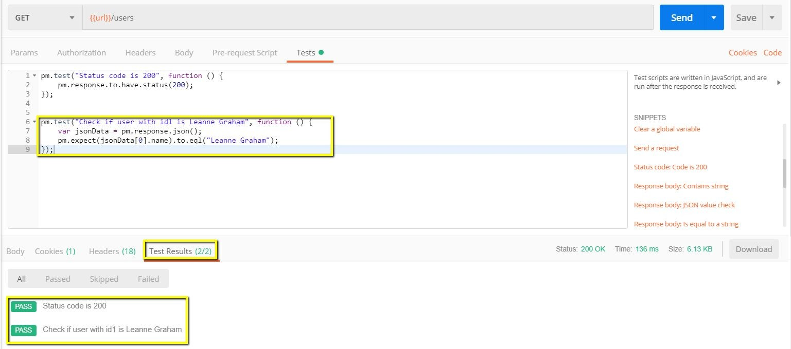
Test Execution Results
Both tests should pass. Status and test names indicated in GUI.

Slide 57
We Have Learned
Unit testing focus on a single class.
System tests focus on high-level functionality, integrating low-level components through a UI/API.
Identify an independently testable function.
Identify choices that influence function outcome.
Partition choices into representative values.
Form specifications by choosing a value for each choice.
Turn specifications into concrete test cases.

Slide 58
Next Time
Choosing system test cases.
Handling infeasible combinations.
Selecting an interesting subset of specifications.

Slide 59
Thank You

